Slide 1
TCP/IP Network Fundamentals
UEEN2013/UEEN2423
(Topic 02)
Managing an Internetwork

Slide 2
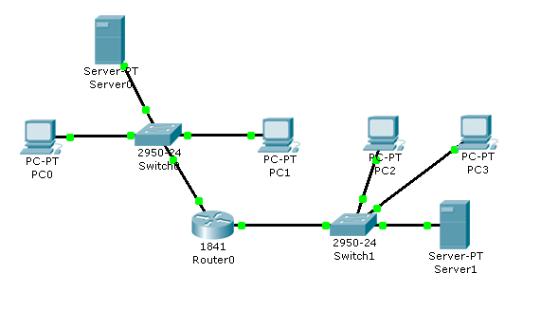
IP Address Design Plan
Static IP:
192.168.1.100
DHCP Server (192.168.1.5-54)
Static IP:
192.168.1.1
Dynamic
IP
Dynamic
IP
Dynamic
IP
fa0/0:
192.168.1.200
Static IP:
192.168.2.1
Note: Router ports’ IP have to static IP (ALWAYS)
1.DHCP Server (192.168.2.5-200)
2.HTTP Server
3.DNS Server
fa0/1:
192.168.2.254

Slide 3
Building your first LAN in Packet Tracer
Your first guide on Packet Tracer
Forming a simple LAN
step by step

Slide 4
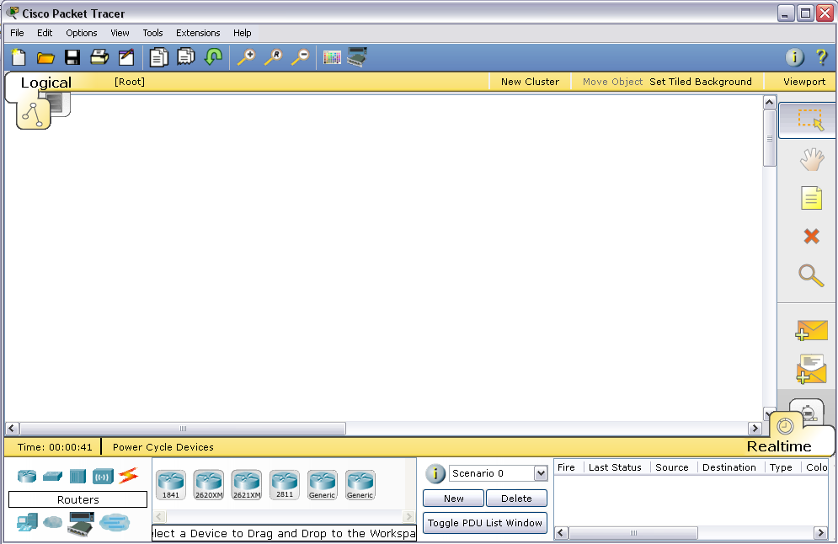
When you Open Your Packet Tracer
Workspace
Network Components
Specific Models

Slide 5
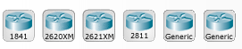


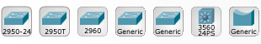

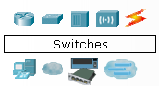



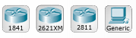

Network Components
Network components in Packet Tracer 5.3
Hubs
Routers
Wireless
Devices
Switches
End Devices
Multiuser
Connection
(cables)
Connections
WAN Emulation
Custom made Devices

Slide 6
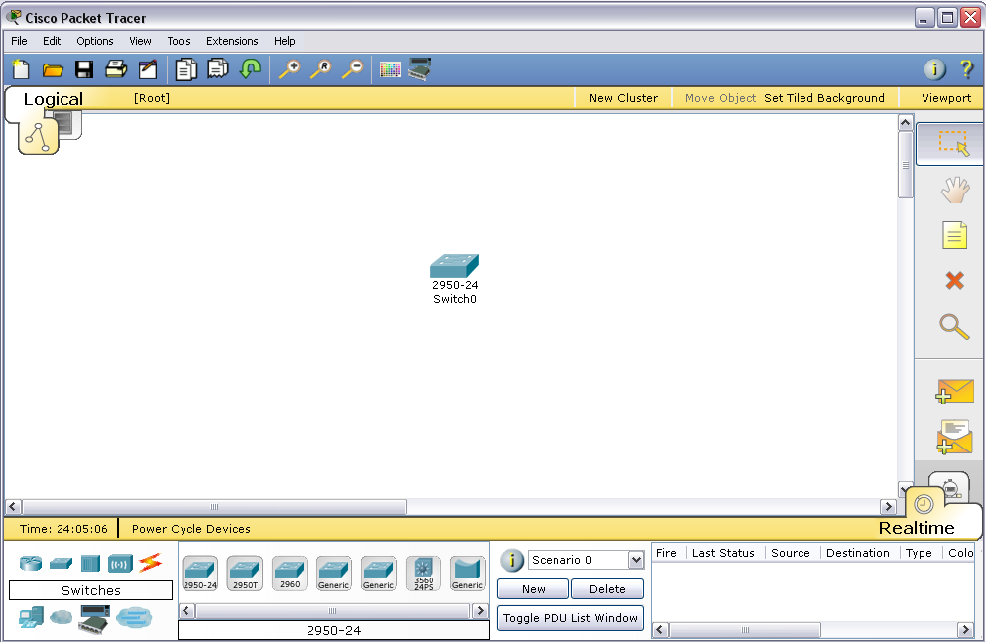
Switch
1.Click here first
to get “Switches”
2. Left click on “2950-24”
and drag this switch into workspace

Slide 7
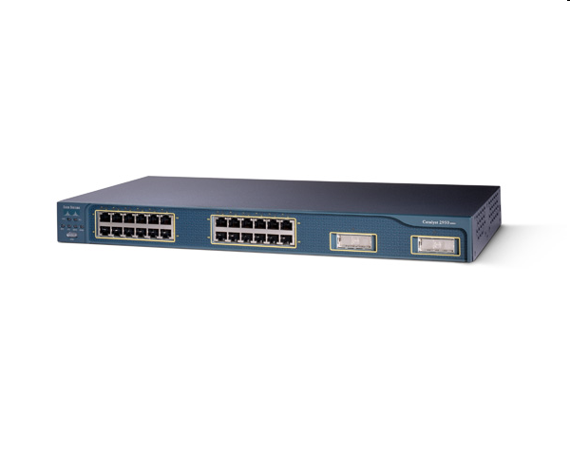
2950-24 Switch
Network Switches are used to form a simple local area network (LAN)
Cisco Catalyst 2950-24
have 24 10M/100M ports
The port here (hardware) is different from “port number” (software)
10M = 10Mbps, 100M = 100 Mega bits per second (Mbps)
100M is what we call “Fast Ethernet”
10M is what we call “Ethernet”
Each of the switch ports is named as
fa0/1, fa0/2,….fa0/24
switch ports

Slide 8
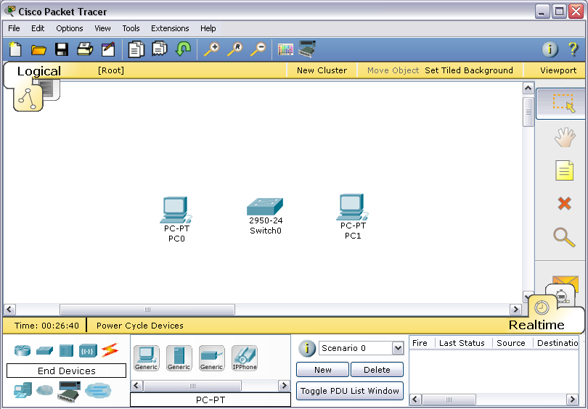
PC
1.Click here first
to get “End Devices”
2. Drag two “Generic” PCs in workspace

Slide 9
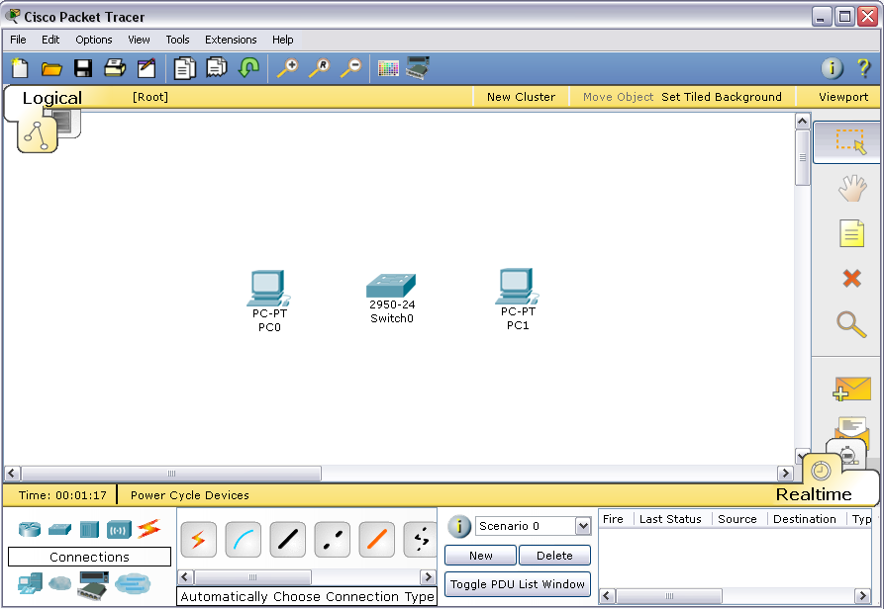
Connection - 1
1.Click here first
to get Connections
2. Click on
“Automatically Choose Connection Type”

Slide 10
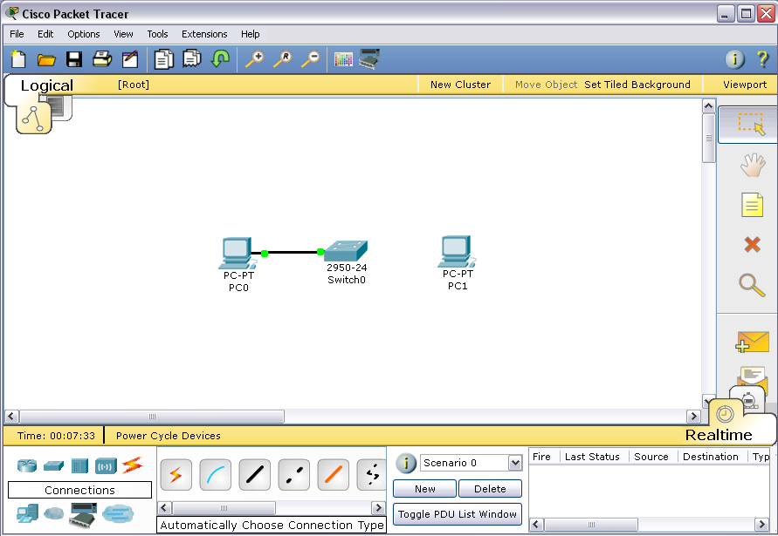
Connection - 2
Click on both PC0 and Switch0 to form a connection.
Do the same to connect a cable for PC1 and Switch0
4. Click on Switch0
3. Click on PC0

Slide 11
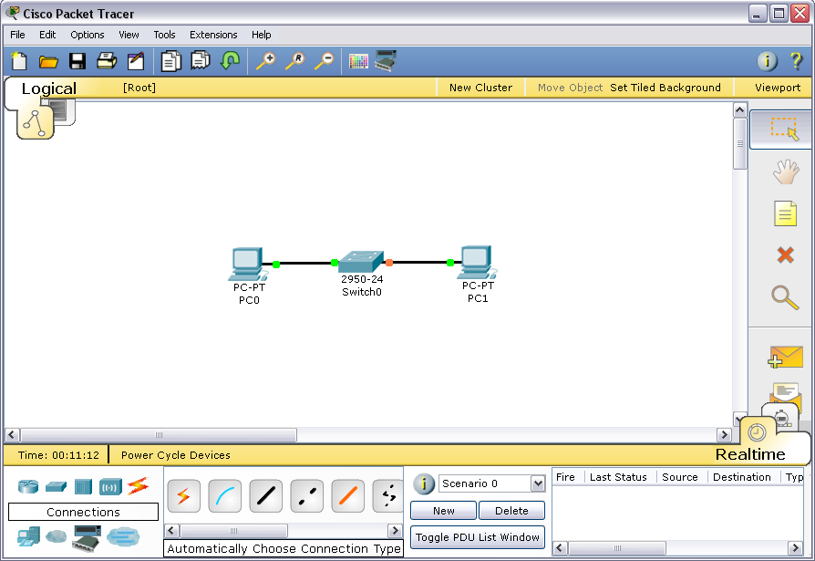
Connection - 3
Wait for the little orange bubble to turn green.
Green bubble (communication is ready)
Orange bubble
(communication is not ready)

Slide 12
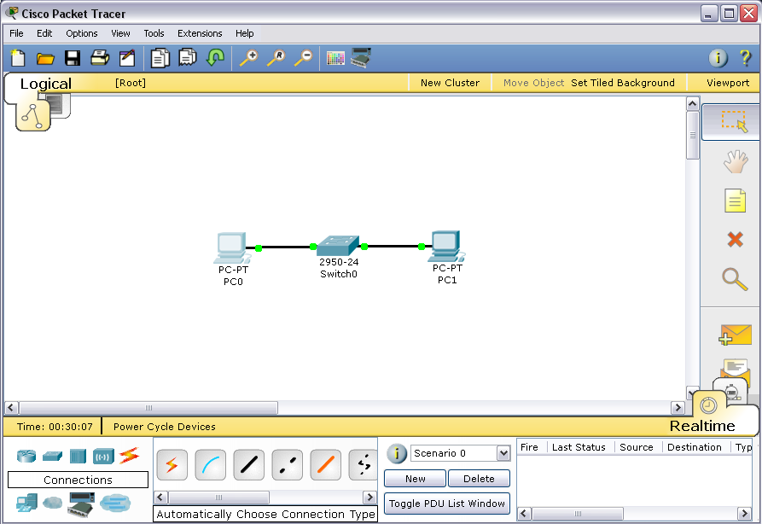
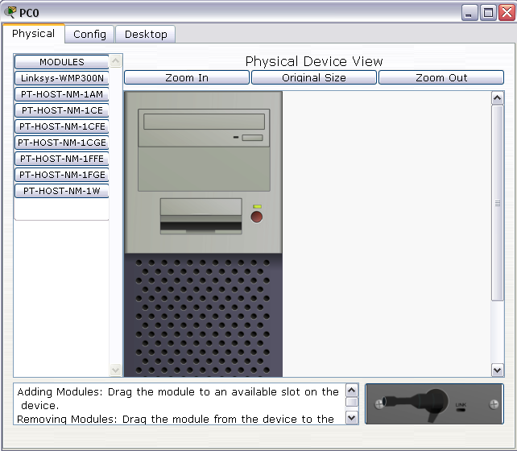
Configuring the PC - 1
Double click on PC0 to call out the PC0 window
1. Double click on PC0
3. Click on
Desktop
2. This window will
Appear.

Slide 13
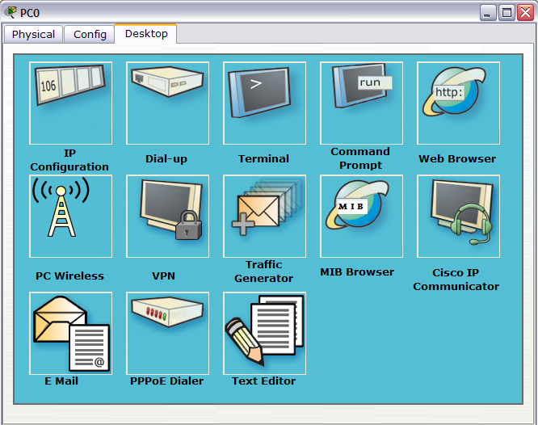
Configuring the PC - 2
4. Click on
IP Configuration

Slide 14
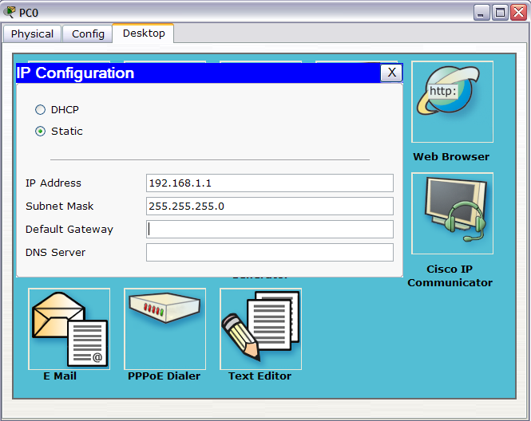
Configuring the PC - 3
9. Press this to close the
PC0 window
8. Press this to close the
IP Configuration window
5. Enter 192.168.1.1
6. Press Tab key
7. 255.255.255.0 will
automatically appear

Slide 15
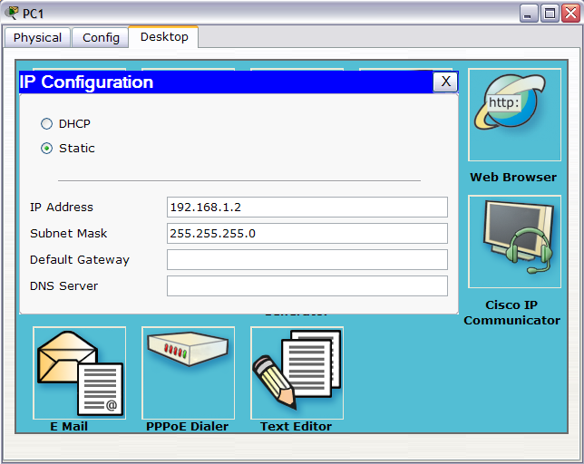
Configuring the PC - 4
Repeat the same procedure for PC1.
Enter 192.168.1.2 for PC1
Close the IP Configuration window but not the PC1 window

Slide 16
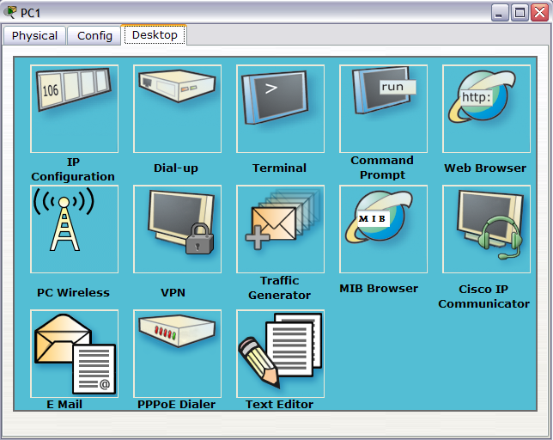
Testing connectivity - 1
1. Click on
Command Prompt

Slide 17
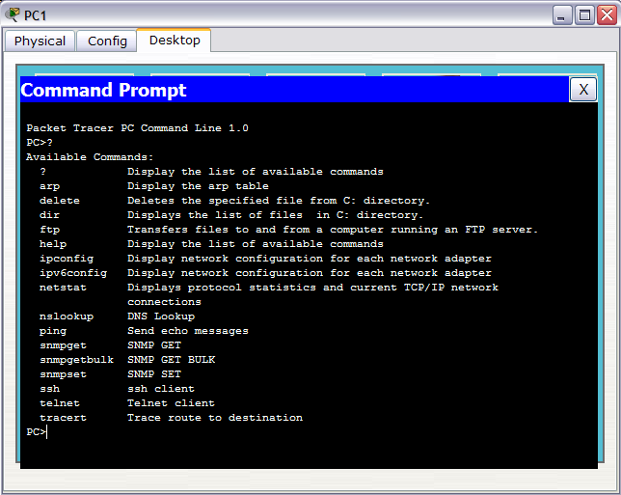
Available Commands in PC
Command prompt in PC of Packet tracer resembles the real life but with limited sets of commands.

Slide 18
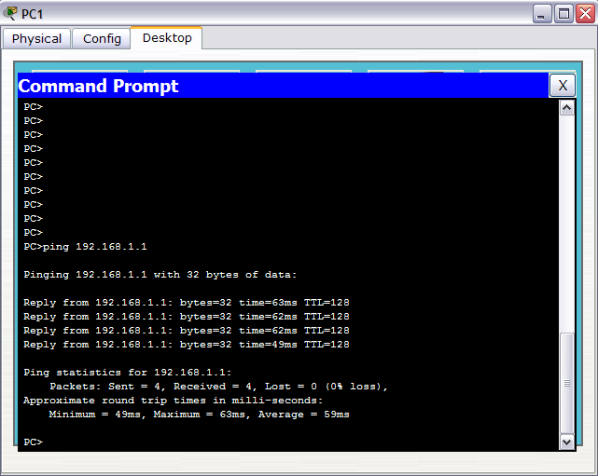
Testing connectivity with ping
1. ping PC0
(ip = 192.168.1.1)
Successful ping !!
Note: ping is a to and fro process. You don’t need to ping from the other side once this side is ok.

Slide 19
DHCP Server in Your LAN
Adding a DHCP server to your LAN
step by step

Slide 20
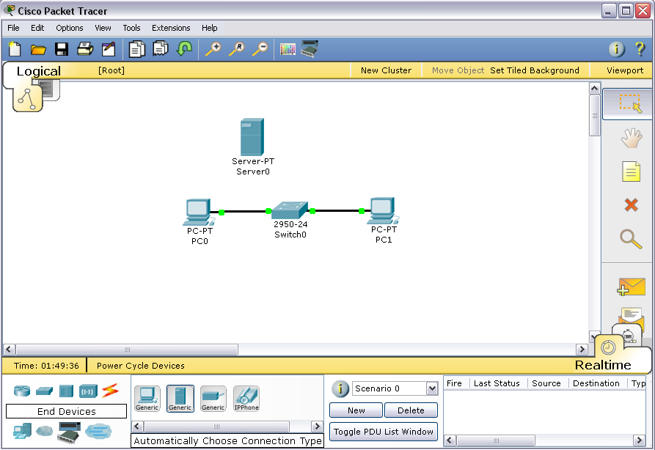
Server
Drag a server in your “existing” LAN
1.Click here first
to get “End Devices”
2. Drag a “Generic” server in workspace.

Slide 21
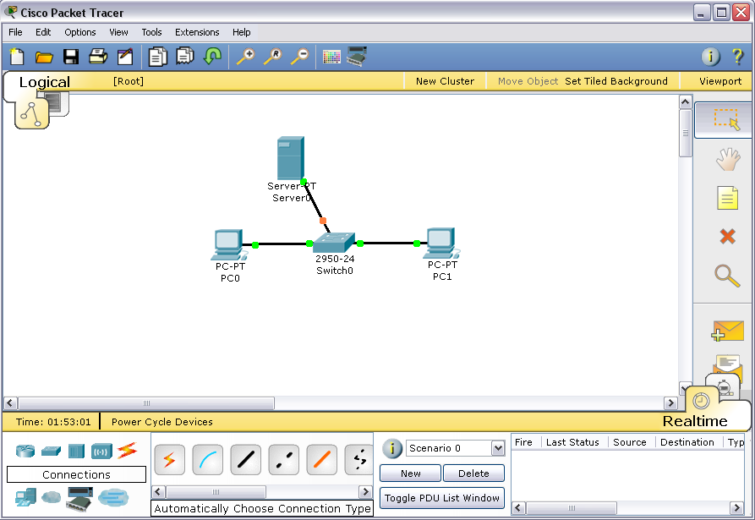
Make Connection
Connect Server0 to Switch0.
3. Click on Server0 and then Switch0 to make a connection.
1.Click here first
to get Connections
2. Click on
“Automatically Choose Connection Type”

Slide 22
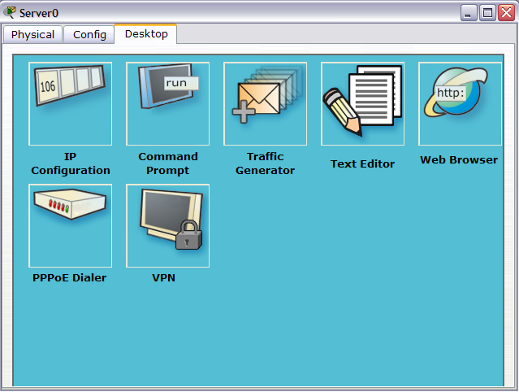
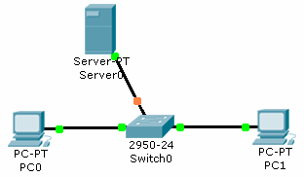
Configuring IP for Server - 1
Double click on Server0, a Server0 window will appear.
1. Click on
IP Configuration

Slide 23
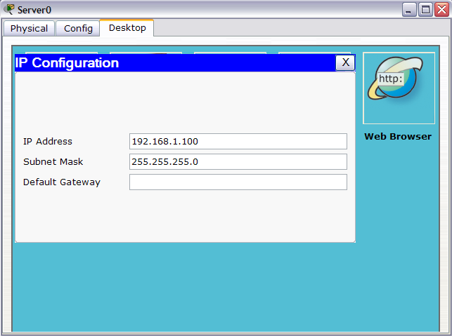
Configuring IP for Server - 2
6. Then click on Config
5. Press this to close the
IP Configuration window
2. Enter 192.168.1.100
3. Press Tab key
4. 255.255.255.0 will
automatically appear

Slide 24
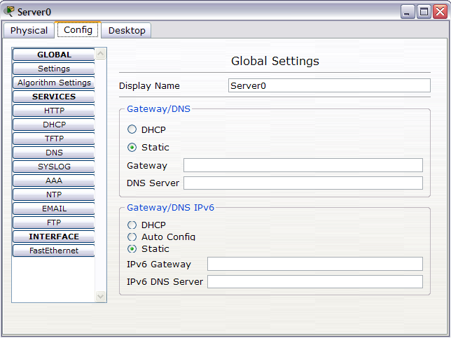
Setting DHCP service - 1
1. Click on
DHCP

Slide 25
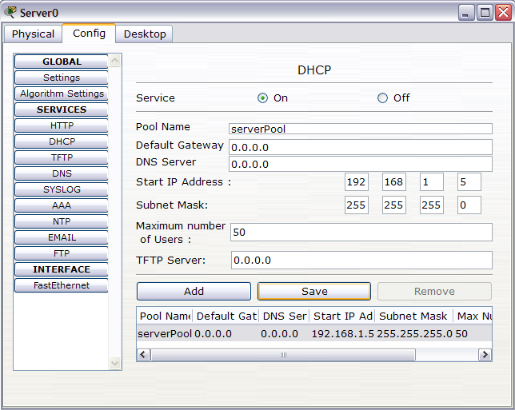
Setting DHCP service - 2
Setting the DHCP IP range from 192.168.1.5 to 192.168.1.54
If there are 52 PCs in the network, DHCP is not able to provide the remaining two PCs.
2. Change Start IP
address to 192.168.1.5
3. Change to 50
4. Press “Save”

Slide 26

Testing DHCP Service
6. You may test the PC1 with a ping to/from PC0
5. If your DHCP is set correctly, you will obtain a dynamic IP
4. Click on DHCP
3. Click on IP Configuration
2. PC1 windows pop up, click Desktop tab.
1. Double click on PC1

Slide 27
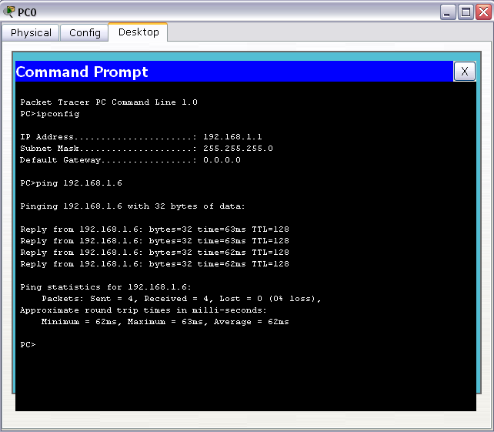
Testing PC1 from PC0
1. Go to command prompt of PC0
2. Type “ipconfig” to check the IP of PC0
3. Ping PC1

Slide 28
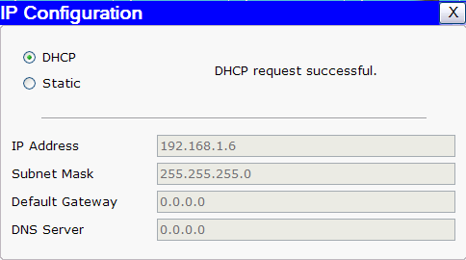
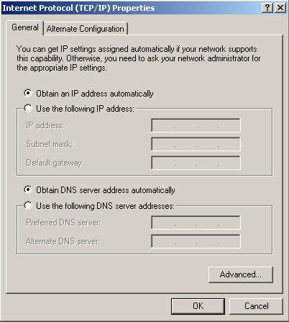
DHCP: Packet Tracer & Real Life
The “DHCP” option is equivalent to “Obtain an IP address automatically” under Windows XP.
Real Life
Packet Tracer

Slide 29
Review: Static IP and Dynamic IP
As you’ve known, IP address in your PC is assigned one of two ways:
The IP is set manually (Static IP)
The IP is set by DHCP services (Dynamic IP)
Comments on Static IP
Normally used for servers, printers, and routers.
Not advisable for large network due to maintenance.
Need to keep track.
Easily set duplicate IP due to negligence (human error).
Comments on Dynamic IP
Used in normal PCs of large networks where it is relatively easier to maintain.
Used in wireless network where the computers/laptops are mobile (in and out all the time).

Slide 30
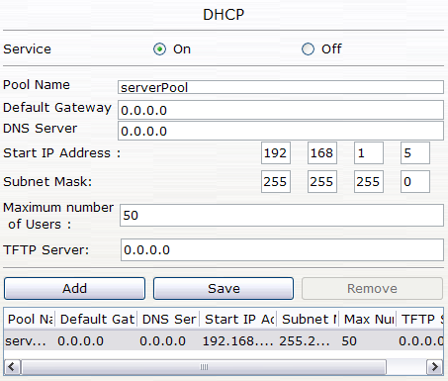
Packet Tracer DHCP Service
A typical DHCP service configuration consists of:
IP address range
1 Subnet mask
1 Default Gateway
2-4 DNS server IP
The IP address range is configured with:
Starting IP Address
Maximum # of users.
TFTP Server IP is NOT a typical DHCP configuration.

Slide 31
Router in Your LAN
Adding a Router to your LAN
step by step

Slide 32
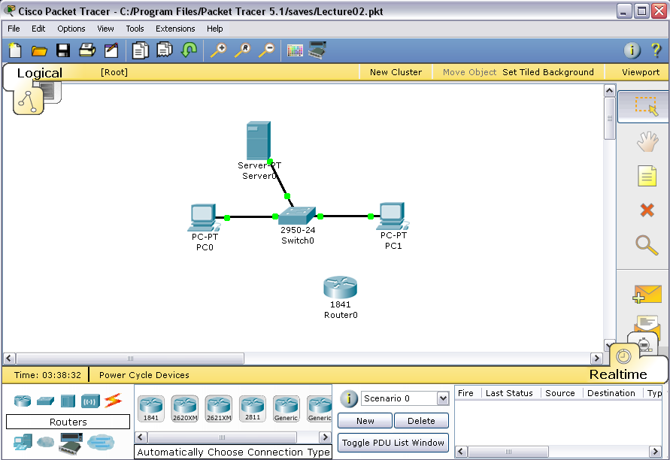
Router
Drag a 1841 router into the workspace.
1.Click here first
to get “Routers”
2. Click on
“1841” and drag it the workspace.

Slide 33
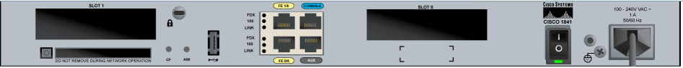
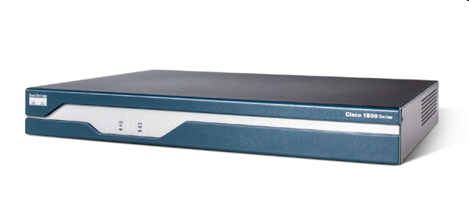
Cisco 1841 router
Console port
Rear View
Slot for module
(will discuss later)
Fast
Ethernet
ports
(fa0/0 and fa0/1)
Slot for module
(will discuss later)
Aux port
On/off switch
Front View

Slide 34
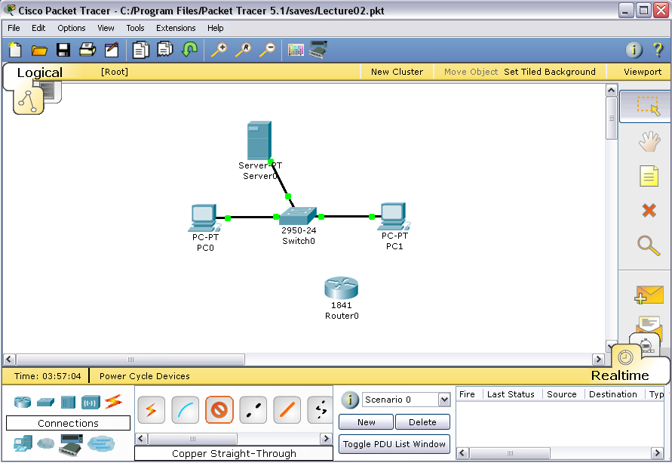
Connecting Router to Switch - 1
1.Click here first
to get Connections
2. Click on
“Copper
Straight-Through”

Slide 35
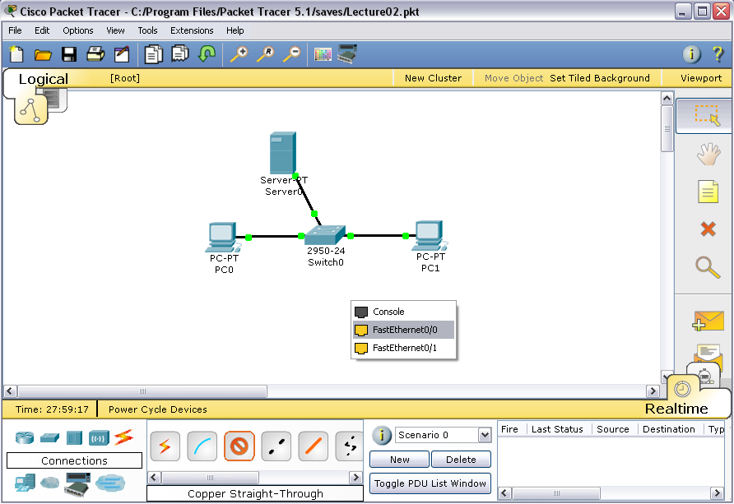
Connecting Router to Switch - 2
3. Click on
Router0, a small
window pops up.
4. Select
FastEthernet0/0,
then click on it

Slide 36
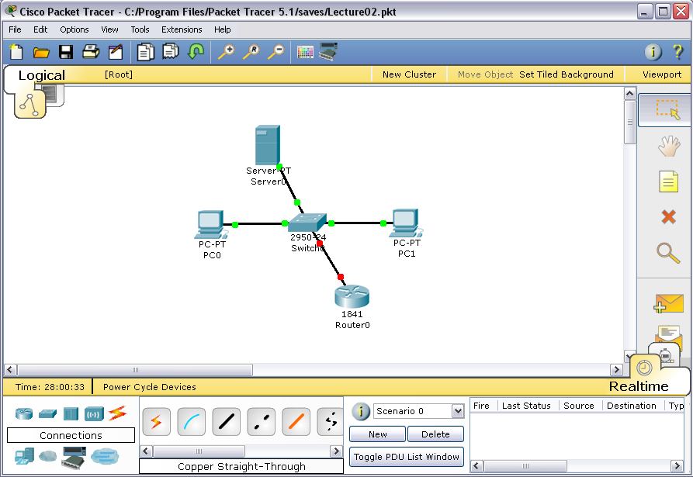
Connecting Router to Switch - 3
6. Click on Switch0
Select
FastEthernet0/4,
then click on it
7. Red bubble
(not communicating)
Remember port fa0/0 is connected to the Switch0

Slide 37
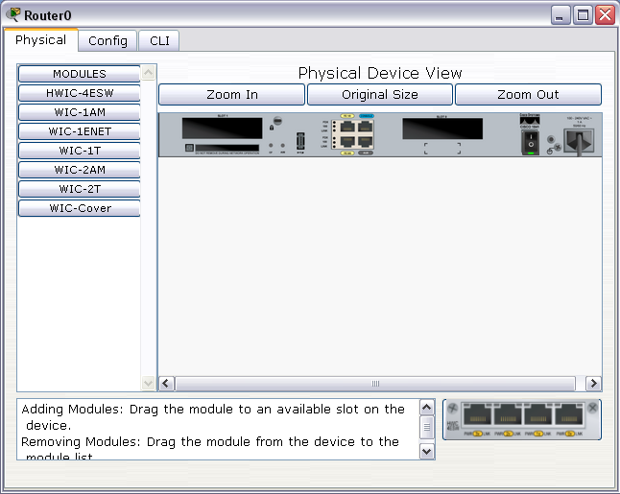
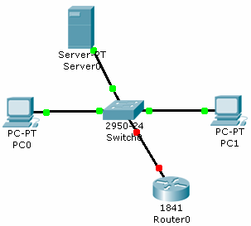
Configuring IP in Router - 1
Double click on Router0 so that this window can pop up.
1. Click on “CLI” tab
to go into the router configuration screen.

Slide 38
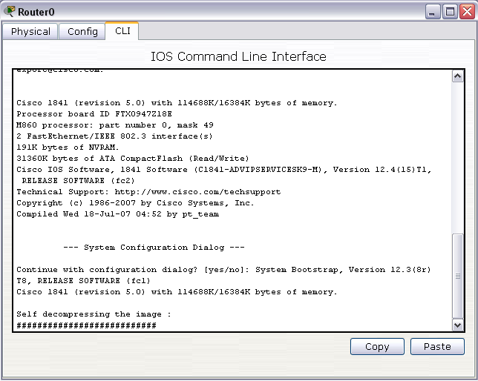
Configuring IP in Router - 2
Wait for the router to boot up

Slide 39
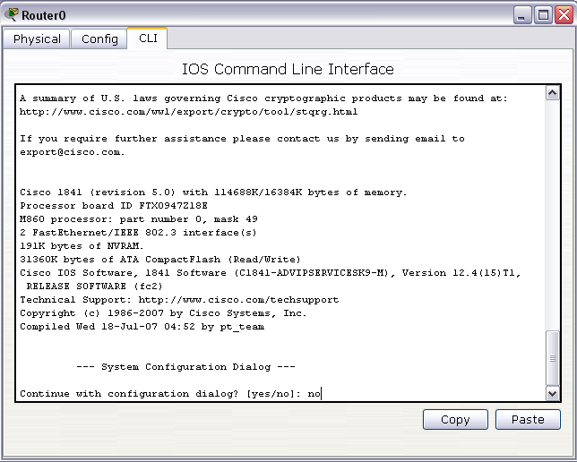
Configuring IP in Router - 3
Type “no” and press enter to continue.

Slide 40
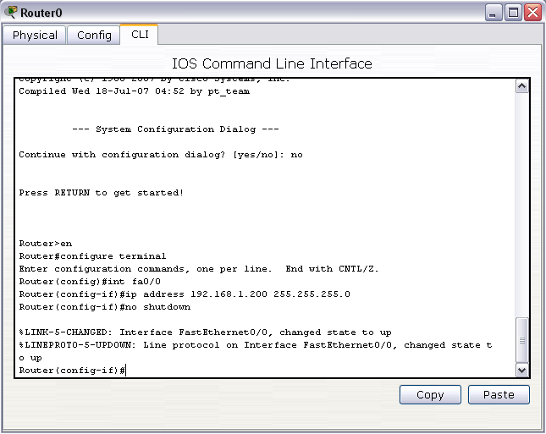
Configuring IP in Router - 4
Set port fa0/0 to have ip = 192.168.1.200
1. Press ”enter” to continue
2. Type ”enable” or “en”
3. Type ”configure terminal” or “conf t”
4. Type ”interface fa0/0” or “int fa0/0”
5. Type ”ip address 192.168.1.200 255.255.255.0”
6. Type ”no shutdown”

Slide 41

Router IP = Gateway of LAN
The interface fa0/0 has a IP of 192.168.1.200.
This IP will be the default gateway IP for all the hosts in the LAN
IP address =
192.168.1.200
Turn from red to green bubbles after the command “no shutdown” (ready to communicate)

Slide 42
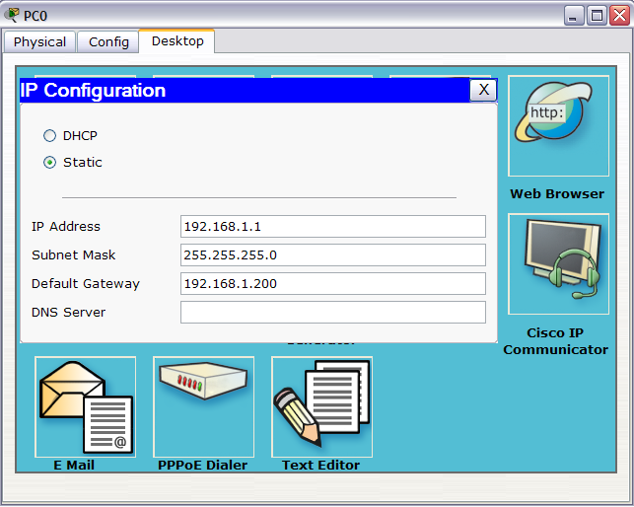
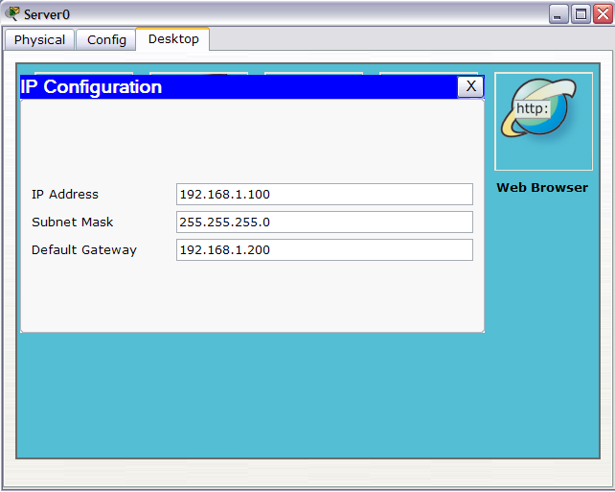
Key in Default Gateway IP in Hosts
Key in 192.168.1.200 as the default gateway of PC0 and Server0
Since both hosts are configured as static IP

Slide 43
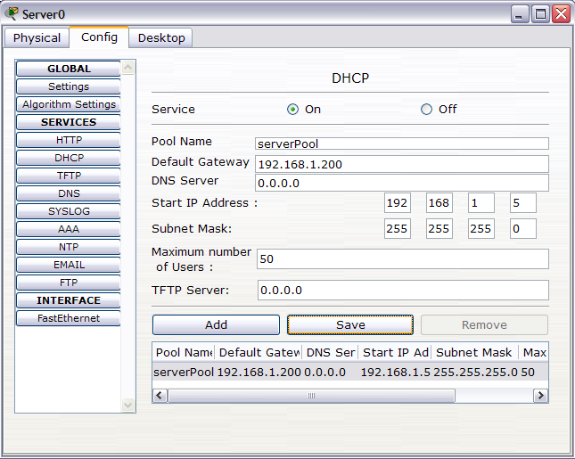
Key in Default Gateway IP in DCHP service
The default gateway IP in DHCP service is different from the default gateway IP of Server0 in terms of functionality
Default gateway IP in Server0 belongs to Server0 itself.
Default gateway in DHCP service is for other host that request DHCP service.
The same default gateway IP in DHCP service can’t be sent to Server0 itself.
1. Press
”Config” tab
2. Press
”DHCP”
3. Change 0.0.0.0 to 192.168.1.200
4. Click on save

Slide 44
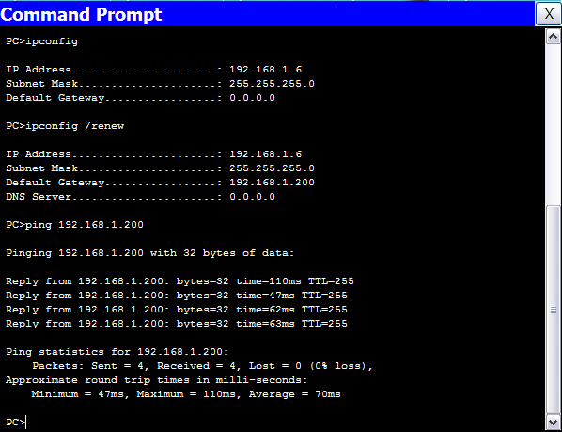
Dynamic IP in PC1
1. Type ”ipconfig” to check the existing IP
2. Type ”ipconfig /renew” to renew the dynamic IP from DHCP service, since the default gateway IP is added.
3. Type ”ping 192.168.1.200” to check the connectivity to router interface (default gateway)

Slide 45
Adding a new LAN
Adding and configure a new LAN on the existing network step by step

Slide 46
The design plan for second LAN
Keep it as a good habit to plan for your network design.
The design plan for second LAN:
The network components needed
1 Switch
2 PCs
1 server
The services
DNS: Set 192.168.2.1 as “www.uccn1003.com”
HTTP
DHCP (dynamic IP for PCs in 2nd LAN)
Server IP (preferred static) = 192.168.2.1
Default gateway IP = 192.168.2.254
DHCP range for the PCs => 192.168.2.5 to 192.168.1.200
DNS IP = Web Server IP = 192.168.2.1

Slide 47
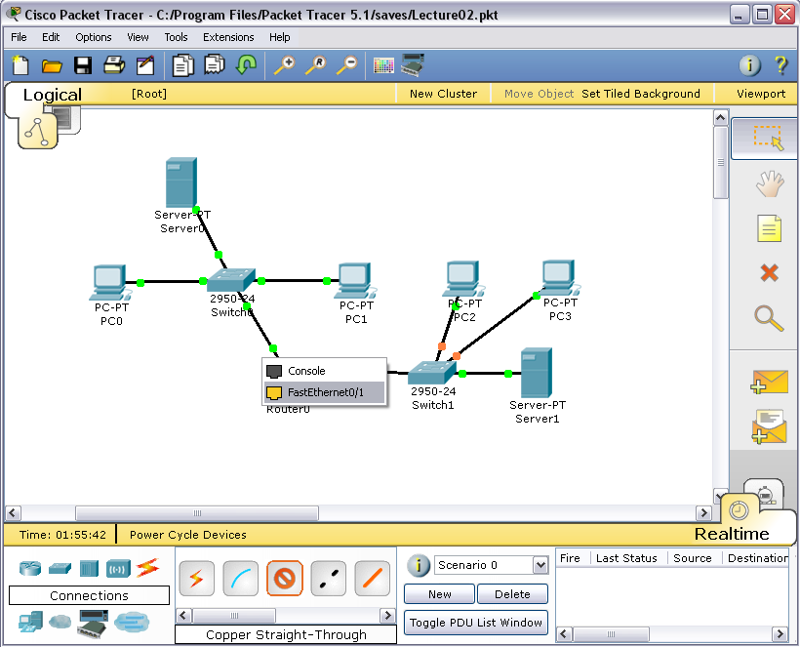
Adding new network components
Add to the workspace
1 2950-24 switch
2 Generic PCs
1 Generic server
Make connection with “Automatic Choose Connection Type” for
PC2 to Switch1
PC3 to Switch1
Server1 to Switch1
Make connection with “Copper Straight-Through”
Switch1 to Router0
FastEthernet0/1 of Router0
FastEthernet0/4 of Switch1

Slide 48
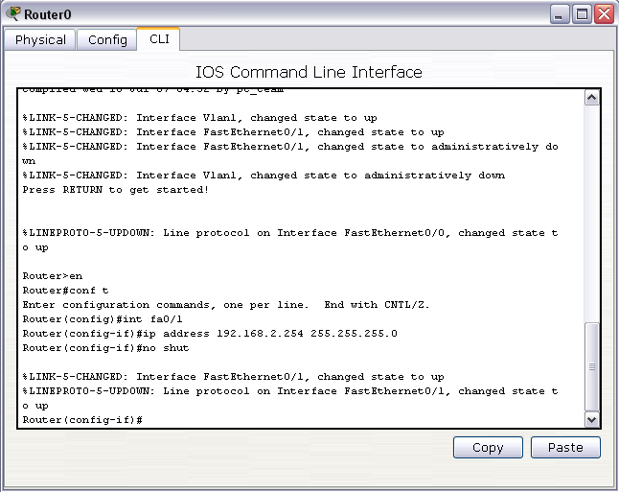
Setting IP for Fa0/1 in Router0
Set port fa0/1 to have ip = 192.168.2.254
1. Type “en”
2. Type ”conf t”
3. Type ”int fa0/1”
4. Type ”ip address 192.168.2.254 255.255.255.0”
5. Type ”no shut”

Slide 49
Caution on Setting IP on Router
Router ports (e.g. fa0/0, fa0/1) are set with static IP.
Note: the port here is a physical port, not the port number (services) that we have discussed.
Make sure that you set your IP on the correct Router ports. For example:
The original design
fa0/0 = 192.168.1.200,
fa0/1 = 192.168.2.254
But you mistakenly set
fa0/0 = 192.168.2.254 (fa0/1 ‘s IP)
fa0/1 = 192.168.1.200 (fa0/0 ‘s IP)

Slide 50
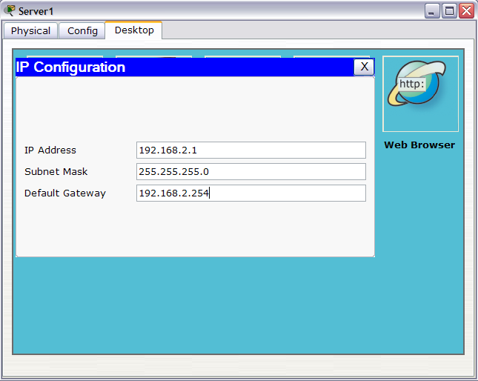
IP Configuration of Server1
The setting of the server IP, subnet mask and gateway.

Slide 51
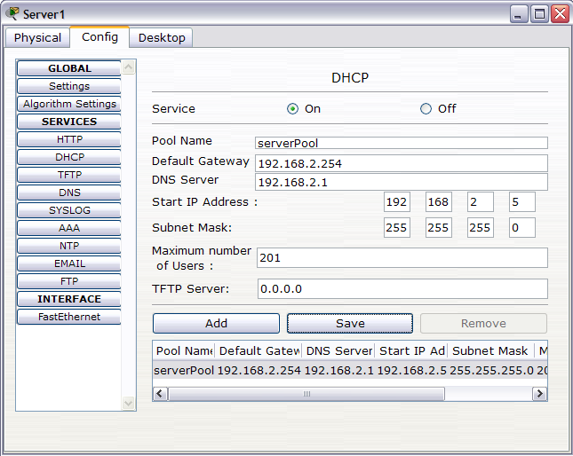
DHCP service setup of Server1
Set Default Gateway IP
= 192.168.2.254
Set DNS IP
= 192.168.2.1
Set Start IP address
= 192.168.2.5
Set Max # of Users
= 201

Slide 52
Comments on Second DHCP Service
DHCP service in Server1 does not service PC0 and PC1, it can only service PC2 and PC3.
Same as Server0, only servicing PC0 and PC1
DHCP service can not “cross” Router.
Whereas, HTTP, DNS service can “cross” Router
Service boundary of
DHCP service of
Server1

Slide 53

HTTP service setup of Server1
Click on “Config” tab and then “HTTP” button to go the HTTP screen.
Type in or modify the web page as shown

Slide 54

DNS Service setup of Server1
1. Click DNS
2. Type in these
3. Press the “Add” button.
Domain name www.uccn1003.com is now associated with ip 192.168.2.1

Slide 55

Requesting Dynamic IP for PC3

Slide 56

Testing Connectivity for PC3
PC3 ping gateway
(fa0/1 of Router0)
PC3 ping PC0

Slide 57

Requesting Dynamic IP for PC2

Slide 58

Launch Web Browser for PC2
Click on this

Slide 59

PC2 Access Web Page in Server1
PC2 has successfully communicate with the DNS to resolve the domain name www.uccn1003.com
PC2 has successfully access the web page hosted in 192.168.2.1 (Server1)

Slide 60

PC1 Access Web Page in Server1
PC1 unsuccessfully access the web page since the hostname is unresolved.
Need to troubleshoot the DNS mechanism…

Slide 61

Troubleshoot PC1: ipconfig
Check PC1 with “ipconfig /all”.
The DNS IP is missing = 0.0.0.0
Check with nslookup => Not working
PC1 is under dynamic IP
We need to fix it first on the DHCP server.
Note: Keep it as a habit that whenever you troubleshoot the network always start with “ipconfig”

Slide 62

Fixing the DNS IP in DHCP
Change the DNS Server IP from 0.0.0.0 to 192.168.2.1
Remember to click
“Save”

Slide 63

Request New Dynamic IP in PC1
Renew Dynamic IP
Since DNS server IP is added
Check again with nslookup on domain name “www.uccn1003.com”
PC1 ping web server

Slide 64

Launch Web Browser in PC1
PC1 Successfully access web page www.uccn1003.com

Slide 65

PC0 and DNS
Though PC0 can ping DNS, this does not mean you can resolved hostname in the web browser.
Since PC0 doesn’t have the DNS server IP.
PC0 is set under static IP.

Slide 66


Launch Web Browser in PC0
Successful !!
Key in the DNS IP

Slide 67
LAN Design Issues
Describing various design issues, principles, and guidelines of LAN, especially on the physical aspect of LAN (e.g. topology, cables, boundary of LAN, etc)

Slide 68
Overview of LAN Design Issues
There are two aspect of LAN design issues:
Physical issues
Issues from IP address
Physical Issues of LAN deals with
Network Topology
LAN boundary
Cables and connecting the equipments
Placement of servers/services
Issues from IP address (Later lecture)
IP address design after physical LAN layout
IP subnet rules

Slide 69
Network Topology

Slide 70


End Devices & Networking Devices
End-devices:
Networking devices:
In LAN design:
We need to learn how to connect these devices together with cables in order to form a network.
Network topology shows us a few way to do this.

Slide 71
Network Topology - 1
Network topology: is the study of the arrangement or mapping of the elements (links, nodes, etc.) of a network, especially the physical (real) and logical (virtual) interconnections between nodes.
Bus topology: the nodes connect to a common backbone or trunk.
Star topology: links all nodes of the network to a central node.
Ring topology: each node connects to another in a closed loop.
Mesh topology: nodes are “randomly” connected to one or many nodes.
* A node can be an end device or a network device.

Slide 72

Network Topology - 2
Network can be formed with any combination of these network topologies in order to connect the network devices.

Slide 73

Example 1:
LAN where PCs and server connected to a switch forms a star-topology
The whole big network forms a tree or hierarchical topology
Hierarchical
Star
Star

Slide 74
Example 2: LAN
In LAN design, the most common topology is star topology
All data that is transmitted between nodes in the network is transmitted to this central node, then retransmits the data to some or all of the other nodes in the network
Star-topology LAN is normally formed by connecting the servers and PCs to a switch, or a hub.
Switches and hubs are normally not required to be configured to form a LAN.
Switches and hub will automatically communicate and transfer data among hosts (PCs), once these hosts are connected to the switch or hub.
Switch is a much superior central node than hub since switch provide higher data transmission (or bandwidth) than hub.

Slide 75

Example 3: Enterprise Network
In enterprise network, hierarchical/tree topology is normally the preferred network topology.
An efficient enterprise network is normally organized as a hierarchy/tree of LANs.

Slide 76

Example 4: Internet
The Internet is a mesh topology.

Slide 77
Issues of Network Topology
Bus
Least wire used
Disastrous if link is fail. Not efficient as host increases
Star and Extended Star
Cheaper than mesh, good fault isolation, easy to install, good connectivity
Bottle neck in the central hub.
Ring
Less wire used than mesh
Medium efficiency and fault isolation
Mesh
Full connectivity, good fault isolation
Require a lot resources (cable, I/O ports)
Hierarchical (or tree)
Hierarchical organized, most widespread network infrastructure topology
Need multiplexing equipment, bottleneck at the top node

Slide 78
LAN Boundary

Slide 79

Overview of LAN Boundary
A LAN is a set of end-devices connected to switches/hubs bound by routers.

Slide 80

Still the same LAN with switches and hubs
Still 1 LAN
PC0 is still in the
same LAN as
Server1, Printer0,
PC1, PC2, PC3,…
No matter how many switches and hubs (of different models) are connected together, functionally they still form the same one LAN.

Slide 81

Routers – Boundary of LAN
LAN 4
LAN 2
LAN 3
LAN 5
LAN 1
Router is the boundary of the LAN
This “boundary” of a LAN is the location of the gateway, which is router port configured with an IP address.
Every host in that LAN has to set its gateway to that IP address.

Slide 82
Routers – Boundary of LAN
Gateway for LAN 2
Gateway for LAN 4
Gateway for LAN 1
Gateway for LAN 5
Gateways for LAN 3
Unlike switches, you have to configure a router before it can be used in a network
At least you need to configure the IP addresses for the router ports
Gateways are the “escape door” from a LAN to the next LAN.
A LAN can have more than 1 gateway.

Slide 83
Cables and Connections

Slide 84

Common Types of Cables in Network
In networks, we use cables to connect various end devices and networking devices.
Examples of types of cables used:
Rollover cable
Ethernet copper straight through
Ethernet copper cross-over
Fiber optics
Telephone cables
Coaxial
Serial cables
The cables below are available in Packet Tracer simulator

Slide 85

Rollover Cable
Rollover cable is a cable with a serial connector at one end, and a RJ-45 connector at the other end.
Rollover connects the serial (comm) port of a PC to the console port of a router.
Rollover cable is only used for router configuration, not data transfer in network.

Slide 86



Ethernet Copper Cable (Cat 5)
There are two types of cable to connect the Ethernet ports in the LAN of the PC, switches, and routers.
Straight-through and Crossover
Both type of cables are a type of twisted pair copper wire cable for LAN use for which the RJ-45 connectors at each end
Both of them look the same, except for the conductors arrangement shown below.
Straight-through cables have the same pinout (i.e., arrangement of conductors).
Crossover cable, the wires on the cable are crossed over so that the receive signal pins on the connector on one end are connected to the transmit signal pins on the connector on the other end.
RJ-45 connector

Slide 87

Straight-through cables are used in…
Straight-through cables are represented by solid line in Packet Tracer

Slide 88

Cross-over cabled are used in…
Cross-over cables are represented by dashed line in Packet Tracer

Slide 89


Fiber Optics
Optical fibers are used to transmit data using light, which permits transmission over longer distances and at higher bandwidths (data rates) than other forms of communications.
Undersea Internet cables are almost all in fiber-optics.
Transmit up to tens of gigabits per second.
Immune to electromagnetic interference.

Slide 90


Telephone Cables
Traditionally used to connect telephones.
Also used in xDSL modems to connect to phone plug for accessing the Internet.
Quite similar to Ethernet cable but smaller.
(Ethernet)
(Phone)

Slide 91


Coaxial Cable
Traditionally for TV use.
Also used in connection:
from cable modem to cable TV outlet/plug
from satellite dish to decoder (Astro)

Slide 92


Serial Cable
Used in connecting router of an enterprise network to Internet (via Telephone companies (telco), or Internet service provider (ISP))

Slide 93
Placement of Services/Servers

Slide 94



DHCP in a LAN
DHCP service only works within a LAN
DHCP service does not function beyond a router unless otherwise configured
PC1 can’t get
the dynamic IP
from Server0
because Router0
has blocked it.

Slide 95


DHCP Server Placement
1 DHCP server serve 1 LAN
2 LANs need 2 DHCP servers (or service).
Router (and wireless router) can provide DHCP service.
You can have a few DHCP service within a LAN
As long as the DHCP IP range does not clash with each other
Will serve as good backup in case one DHCP server fails

Slide 96

IP Issues on DHCP Service
The DHCP servers has to set with static IP!!
You can NOT set the IP of DHCP servers to dynamic IP!!!
In the following example, the DHCP static IP and gateway IP are in the range of the DHCP service
DHCP service can detect it and won’t assign duplicate IP in the LAN.

Slide 97

DNS Server
DNS server can be set within the LAN (local DNS server).
Unlike DHCP, you can request DNS service beyond your LAN.
Public DNS servers are a GLOBALLY linked.
All the public DNS servers in the world work as “a team” to provide the service to the world.

Slide 98
Local Servers & Remote Servers
Local servers : servers that are best placed within LAN (or within the enterprise network)
TFTP server *
DHCP server
Print server
Security server
Remote servers: servers that can be accessed across the Internet
Email server
Web server
DNS server
FTP server *

Slide 99
* Difference between TFTP & FTP
Both FTP and TFTP are file services
TFTP (trivial file transfer protocol)
Unsecured, no login and password
As a LAN backup file server
Best not to be assessed across the Internet
Not widely deployed.
FTP
Secured, with login and password
sftp (secure ftp), where login, password, and data are encrypted.
For Internet access.

